Slide 1
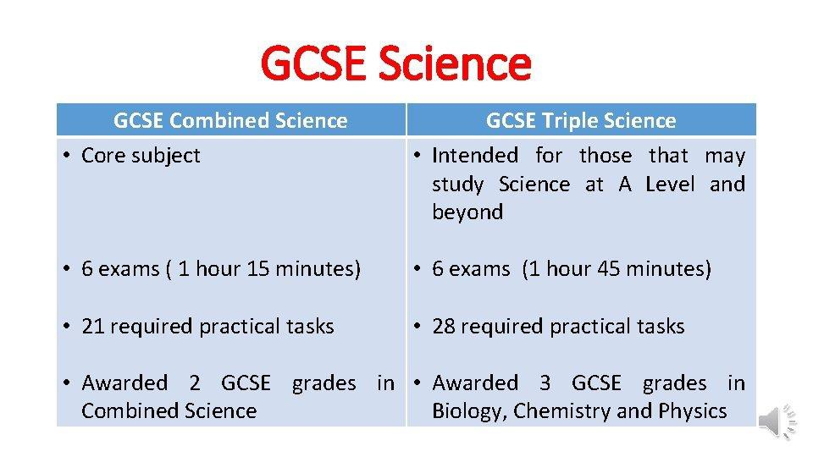

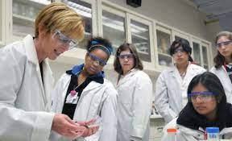

Course Information: Triple Science
The Triple Science course will help you take your first steps towards a career in many professions for example; Midwife, Nurse, Zoologist, Marine Biologist, Aerospace engineer, Chemical engineer, Transportation engineer, Architect, Robotics, Pilot, Astronomer and surveyor, Doctor, Veterninary surgeon, psychologist and many more. At Heritage High School students will follow the AQA Science specification for both Combined Science (Trilogy) or Triple Science. The Triple Science option involves the study of extra topics in Biology, Chemistry and Physics, as well as studying those from Combined Science in more depth.
Additional content present in Triple Science includes: The Use of Antibodies in Medicine, Sustainable Food Production, Nanoscience, The Science of Polymers, Space Science and The Behaviour of Infrared Radiation.
https://www.aqa.org.uk/subjects/science
For further information on this course please contact andrew.birch@heritage.ttct.co.uk

Slide 2
Assessment: Triple Science
You will be assessed through linear examinations at the end of Year 11 for each subject Biology, Chemistry and Physics.
For each subject you will sit 2 external examinations, 6 in total (paper 1 and paper 2) with each paper contributing 50% to each of the final examination grades achieved. Each examination is 1 hour 45 minutes long.
Biology –
Paper 1 covers Cells, Photosynthesis, Moving and Changing Materials and Health Matters.
Paper 2 covers Coordination and Control, Genetics, Variation and Evolution and Ecology in Action.
Chemistry –
Paper 1 covers Atomic Structure, Structure and Bonding, Chemical Quantities, Chemical Changes and
Energy Changes.
Paper 2 covers Rates of Reactions, Hydrocarbons, Chemical Analysis, The Atmosphere and Sustainability
Physics –
Paper 1 covers Energy, Electricity, Particle Model of Matter and Atomic Structure. Paper 2 covers Forces, Waves, Electromagnetism and Space
Student progress will be monitored throughout the course through internal assessments.
For further information on this course please contact andrew.birch@heritage.ttct.co.uk

Slide 3
Do’s and Don’t’s : Triple Science
Do’s | Don’ts
Pick this course if you have a keen interest and made excellent progress in Science during Key Stage 3. | Pick this course because you get on with the Teacher
Pick this course if you have aspirations of going on to do A-level science, work in a science based career or go on to University to study science. | Pick this course just because you might have a group of friends that will be picking it
Pick this course if you want to develop your creativity, problem solving, analysis and evaluation skills. | Pick this course if you think you will be doing practical every lesson, although it involves a lot of practical a lot is also theory based.
Pick this course if you are willing to put the effort in, in class and at home. | Pick this course as you think it is easy…There are NO easy courses!
For further information on this course please contact andrew.birch@heritage.ttct.co.uk

Slide 4
Beyond Heritage: Triple Science
Further Education
Including A level Biology, Chemistry and Physics in preparation and acceptance for University Degree Course's or Apprenticeships.
Life/Employability Skills
Practical ability
You will develop practical skills, being able to work independently and as part of a team through group work.
Problem solving
The majority of job roles require problem solving skills and be able to think creatively when problems arise, their causes and effects and ways to identify a range of possible solutions and then assess and decide the best way forward.
Organisation
You’ll need to be able to prioritize work and meet strict deadlines while also achieving the course criteria, identify and act on any misconceptions to further develop your understanding.
Analytics
You’ll be collecting and examining information in detail to arrive at a solution, to answer a key question or make an informed decision.
Discipline
You need to know and do what is expected of you. This ranges from organizing yourself, being on time, to being responsible. Some jobs need particular discipline skills such as being able to persevere with the task and plans until you accomplish them. Therefore, you need to be hard working and resilient to ensure all tasks are completed to a good standard.
How is Triple different to Combined Science
Combined Science - This course will allow you to access A-levels and apprenticeships like Triple but if you want to embark on a science based career then Triple Science is a better option. If you want to study A-level Sciences then Triple is the better option to provide greater depth of knowledge and understanding.
If you do not need to do Triple then you have to
decide if it will be of any benefit in the future. Here is how they compare:
Triple – Is an optional subject which provides an additional 5 hours of science per fortnight.
6 exams (2 for each subject) each exam 1 hour
45 minutes.
28 required practical activities to complete.
Awarded 3 GCSE grades overall.
There is also the possibility of choosing an apprenticeship, BTEC Level 3 where all of the above can lead to a wide range of careers that either require in depth or a good knowledge of Science
Possible careers could include: Midwifery, Nurse, Zoologist, Marine Biologist, Doctor, Dental surgeon, Aerospace engineer, Chemical engineer, Transportation engineer, Architect, Robotics, Pilot, Astronomer and surveyor.
Combined – Is a Core subject which all students must complete.
6 exams (1 hour 15 minutes each)
Awarded 2 GCSEs
21 Required practical activities to complete.
For further information on this course please contact andrew.birch@heritage.ttct.co.uk

