Slide 1
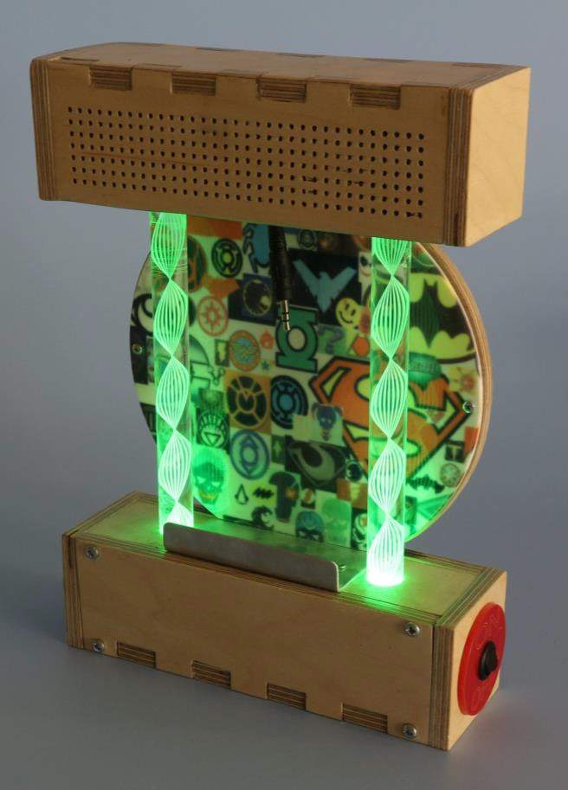
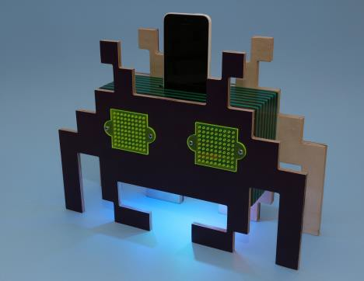
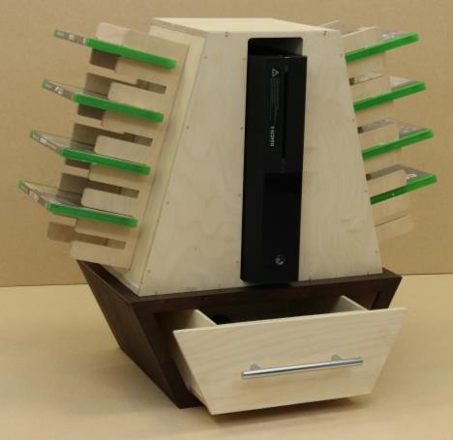
Course Information: Product Design
If you particularly enjoy the creative side of Design and Technology then you now have the opportunity to follow our two-year GCSE course to specialise in Product Design. GCSE Product Design covers a wide range of activities based on designing and making products that are manufactured using materials such as wood, metal and plastics in many forms. As well as learning hand skills, you will use a range of industrial processes to shape and form materials into functioning products. Over the course of two years you will develop a whole range of creative designing and making skills, technical knowledge and understanding relating to Design & Technology and invaluable transferable skills such as problem solving, time management and STEM skills.
For further information on this course please contact jordan.fowler@heritage.ttct.co.uk

Slide 2
Assessment: Product Design
Paper 1 : The first exam paper tests core technical principles, specialist technical principles, and designing and making principles. The written exam is 2 hours in duration and is marked out of 100. This is worth 50% of the GCSE. The questions are split into three sections:
Section A – Core technical principles (20 marks). A mixture of multiple choice and short answer
questions assessing a breadth of technical knowledge and understanding.
Section B – Specialist technical principles (30 marks). Several short answer questions (2–5 marks) and one extended response to assess a more in depth knowledge of technical principles.
Section C – Designing and making principles (50 marks). A mixture of short answer and extended response questions including a 12 mark design question.
Non-exam assessment (NEA) : The practical application of core technical principles is tested alongside specialist technical principles and designing and making principles. The assessment is non-examined, and will require approximately 30-35 hours of study. It is awarded out of 100 marks, and equates to 50% of the final GCSE grade. The assessment requires a substantial design and make task including Investigation, designing, making, analysing and evaluating. Students will also produce a working prototype and a portfolio of evidence. The assessment is internally assessed.
For further information on this course please contact jordan.fowler@heritage.ttct.co.uk

Slide 3
Do’s and Don'ts: Product Design
Do’s | Don’ts
Pick this course if you have a keen interest in Design and Technology and have enjoyed your lesson’s in Y7 and Y8 | Pick this course because you get on with the Teacher.
Pick this course if you want to develop your creativity and problem-solving skills | Don’t pick this course just because you might have a group of friends that will be picking it
Pick this course if you have aspirations of working in the Design and Technology industry | Pick this course if you think you will be doing practical every lesson, the majority of the course is theory/controlled assessment
Pick this course if you are willing to put the effort in. In class and at home. | Pick this course as you think it is easy…There are NO easy courses!
For further information on this course please contact jordan.fowler@heritage.ttct.co.uk

Slide 4
Beyond Heritage: Product Design
Further Education/Apprenticeships
Life/Employability Skills
Potential Career Pathways
A Level/College Courses
include Design and Technology, Product Design (3D), product design (textiles), Systems and Control Technology, Food technology.
Apprenticeships could include junior product designer, theatre set carpenter, farrier, service technician civil engineering technician, Plumber, design and draughting technician, engineering model maker.
Related subjects include Engineering, Art, Graphic design, Media, Music technology, Computing, Maths, Physics, Photography, Textiles.
Technical ability
You may need particular technical skills and specialist knowledge of how things work or need to be designed and built.
Problem solving
Some jobs particularly require problem solving skills and creative thinking to recognise problems and their causes, to identify a range of possible solutions and then assess and decide the best way forward.
Organisation
You’ll need to be able to plan and schedule work. This could include being able to prioritise what needs to be done and by when.
Creativity
You may need specific artistic or design skills for a job, or you may need to draw on a good imagination to come up with creative solutions to business challenges.
Analytics
You’ll be collecting and examining information in detail to arrive at a solution, to answer a key question or make an informed decision.
Discipline
You need to know and do what is expected of you. This ranges from organising yourself, being on time, to being responsible. Some jobs need particular discipline skills such as being able to persevere with the task and plans until you accomplish them, or following strict procedures.
Engineer
Electrician
Brick Layer
Graphic Designer
Illustrator
Architect
Interior Designer
Engineer
Automotive Designer
Product Designer
Carpenter
Joiner
Plasterer
Plumber
Furniture Designer
For further information on this course please contact jordan.fowler@heritage.ttct.co.uk

