Slide 1

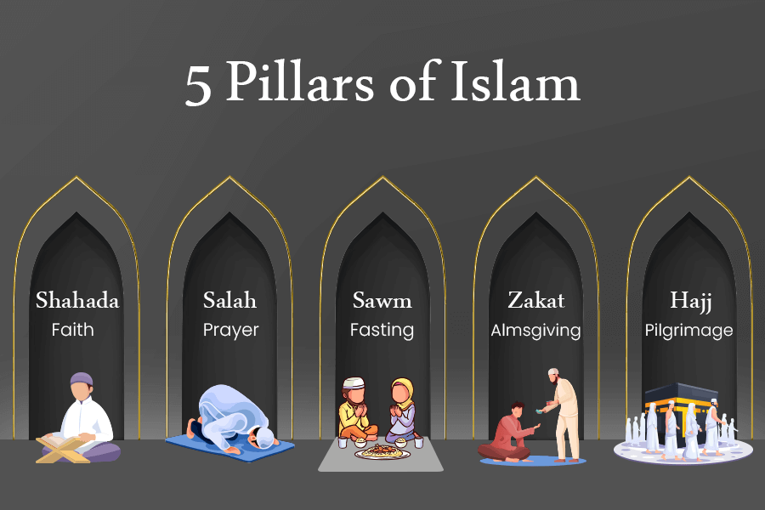



Course Information: Religious Studies (full GCSE)
Students can also opt to study for a full GCSE in Religious Studies. This will build upon the core GCSE lessons.
GCSE Religious Studies will help you to understand yourself and the people around you. You will study the practices of Christianity and Islam in depth.
You will then then look at how these beliefs affect people around the world and apply to issues facing humanity in the 21st Century. We will study Christian, Muslim and non-religious attitudes to issues around:
Life (such as how we should treat the environment, and do we have the right to choose when we die)
Crime and punishment (such as the causes of crime, and how should prisoners be punished).
https://trs.ac.uk/studying-trs/graduate-videos/
For further information on this course please contact frances.morrell@heritage.ttct.co.uk

Slide 2
Assessment: Religious Studies (full GCSE)
This is assessed in 2 exams that will each last for 1 hour and 45 minutes. Students who opt to study the full GCSE will not sit the Short Course exam.
Each paper is split into 4 questions, worth 24 marks. The Christianity and Islam beliefs questions, plus one themes question each have 3 marks for Spelling, Punctuation and Grammar.
The questions are all structured the same, in 5 parts:
Multiple choice knowledge question - 1 mark
‘Give two’ knowledge question - 2 marks
Explain how beliefs influence believers (Beliefs) / Explain religious practices (Practices)/ Explain contrasting beliefs about an issue (Themes) - 4 marks
Explain a belief - 5 marks
Evaluate a point of view about a belief or practice- (Christianity and Islam) or issue (Themes) - 12 marks
Exam 1:
Christian beliefs (studied in core RS)
Christian practices
Islam beliefs (studied in core RS)
Islam practices
Exam 2:
Relationships and families (studied in core RS)
Life
Peace and conflict (studied in core RS)
Crime and punishment
For further information on this course please contact frances.morrell@heritage.ttct.co.uk

Slide 3
Do’s and Don'ts: Religious Studies (full GCSE)
Do: | Don’t:
Pick this course if you have a keen interest in Religious Studies and have enjoyed your lessons in Y7, Y8 and Y9. | Don’t pick this course if you don’t like writing. There are lots of long questions on the exams which we spend lots of time in lesson preparing for.​
Pick this course if you want to develop your discussion, understanding, analysis and evaluation skills.​ | Don’t pick this course just because you might have a​ group of friends that will be picking it.​
Pick this course if you want to understand how other people see the world, and develop your own opinions about a range of issues. | Don’t pick this course if you don’t want to learn more about different beliefs and how they shape how different people live their lives and understand the world.
Pick this course if you are willing to put the effort in, both in class and with your homework.​ | Pick this course as you think it is easy…There are NO​ easy courses!​
For further information on this course please contact frances.morrell@heritage.ttct.co.uk

Slide 4
Beyond Heritage: Religious Studies
A Levels
Life/Employability Skills
Potential Career Pathways
Most 6th forms require at grade 5 to
continue on with Religious Studies.
Teamwork
Problem-solving
Advanced analytical skills
Written Communication
Verbal Communication
Planning
Creative thinking
Time management
Self-motivation and self-reliance
Adaptability
Empathy
Resilience
Independence
Advice worker
Archivist
Charity fundraiser
Charity officer
Chaplain
Civil Service administrator
Community development worker
Editorial assistant
Equality, diversity and inclusion officer
Mediator
Newspaper journalist
Police Officer
Policy officer
Prison Officer
Solicitor
Youth worker
As Religious Studies links with lots of other subjects (including English, Philosophy and Ethics, Psychology, Sociology and History) it is a good subject to continue with at A level as it helps support your other A levels.
You could then continue with Religious Studies, Philosophy or Theology at University as a degree on it’s own.
Alternatively, you can combine it with other degrees e.g. Teaching and Religious Studies.
For further information on this course please contact frances.morrell@heritage.ttct.co.uk

