Slide 1
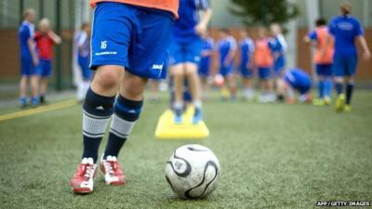
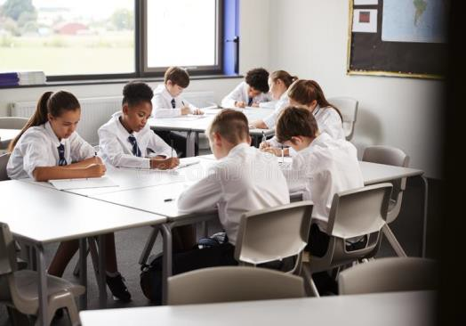
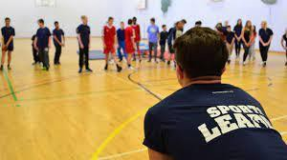

Course Information: Sport Studies
The OCR Cambridge National in Sport Studies will help you take your first steps towards a career in sport, such as coaching, teaching, physiology plus many more. The qualification will also help you to develop skills that can be used in other life situations, such as completing research, working with others, writing reports, leadership skills and planning training programmes.
You will complete an exam, set up and marked by OCR, complete an assignment based on sport and the media, and an assignment where you will apply practice methods to improve your own performance. You will also be moderated for your leadership skills, planning and organising sports activities and competing in an individual and team sport.
https://www.ocr.org.uk/Images/610953-specification-cambridge-nationals-sport-studies-j829.pdf
For further information on this course please contact courteney.csomor@heritage.ttct.co.uk

Slide 2
Assessment: Sport Studies
You will be assessed through a mixture of exams and project work.
R184: Contemporary issues in sport. By completing this unit, you will understand a range of topical and contemporary issues in sport, including learning about participation levels and barriers to completing sport activities, the role of high-profile sporting events and how technology is used in sport.
R185: Performance and leadership in sports activities . In this practical unit you will be assessed in an individual and team sport and umpiring competitive games. You will apply practice methods to improve your own performance in a sporting activity. You will also be given the opportunity to plan and deliver your own sports activity session.
R186: Sport and the media. In this unit you will understand the different sides of a range of media sources and apply real life examples to show the nature of the relationship between media and sport. You will also learn how rapid development in technology is enabling sport to be viewed, replayed and discussed.
For further information on this course please contact courteney.csomor@heritage.ttct.co.uk

Slide 3
Do’s and Don'ts: Sport Studies
Do’s | Don'ts
Pick this course if you have a keen interest in PE and have enjoyed your lesson’s in Y7 and Y8 | Pick this course because you get on with the Teacher
Pick this course if you want to develop your sporting performance, leadership and planning and evaluating skills. | Don’t pick this course just because you might have a group of friends that will be picking it
Pick this course if you have aspirations of working in the sporting industry. | Pick this course if you think you will be doing practical every lesson, some of the course is theory/controlled assessment
Pick this course if you are willing to put the effort in, in class and at home. | Pick this course as you think it is easy…There are NO easy courses!
For further information on this course please contact courteney.csomor@heritage.ttct.co.uk

Slide 4
Beyond Heritage: Sport Studies
Further Education
Life/Employability Skills
Potential Career Pathways
Including BTEC Sport and A level PE courses in preparation and acceptance for University Degree Course's or Apprenticeships.
Team-work
You will develop a range of communication skills, which will
help you to work alongside others.
Leadership
One of the units in the sport studies course focuses upon leadership. These skills will be developed whilst you are leading groups of students in sporting activities.
Organisation
You’ll need to be able to prioritize work and meet strict deadlines while also achieving the course criteria, this is relevant within the Sporting Sector.
Reviewing
You will develop the skill of reviewing when you evaluate your practical performance and when evaluating your leadership sessions.
Planning training programmes
You’ll be planning your own training programme within unit 2 of the sport studies course. This will involve the analysis of your performance and planning a programme to help improve performance, using practice methods.
Discipline
You need to know and do what is expected of you. This ranges from organising yourself, being on time, to being responsible. Some jobs need particular discipline skills such as being able to persevere with the task and plans until you accomplish them.
PE Teacher
Physio Therapist
Coach
Professional Sportsperson
Personal Trainer
Sports Scientist
Sports Consultant
Diet and Fitness Instructor
Outdoor Adventurous Activities Instructor
For further information on this course please contact courteney.csomor@heritage.ttct.co.uk

