Slide 1

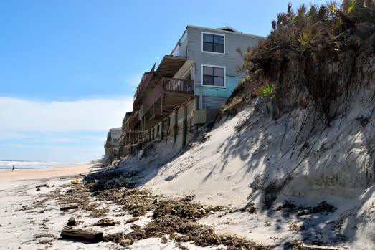
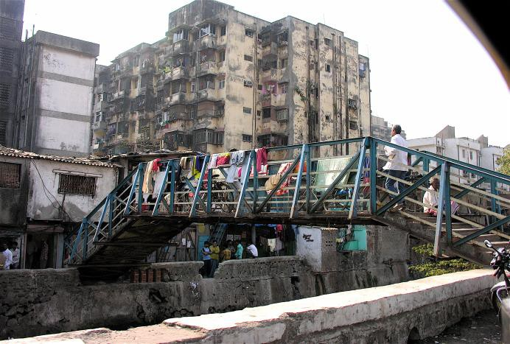

Course Information: Geography
GCSE geography will help you to continue your journey in finding out the world around you. You will continue to understand your place in the world around you and be able to form evidence based opinions of geographical issues.
We travel to places around the world (without leaving the classroom) to investigate issues such as;
- Is deforestation in the tropical rainforest always the
wrong thing to do?
Would redeveloping the Mumbai slums always be in the best interests of the slum residents?
Why might it be a good idea to allow parts of the
coast to fall into the sea and not try and protect it?
https://www.aqa.org.uk/subjects/geography/gcse/geography-8035
For further information on this course please contact amy.farrow@heritage.ttct.co.uk

Slide 2

Assessment: Geography
Paper 1: Our Natural World*
This paper consists of units on: Global Hazards, Climate Change, Distinctive Landscapes and Sustaining Ecosystems
Paper 2: People and Society*
This paper will teach you about: Urban Futures, Dynamic Development, UK in the 21st Century and Resource Reliance.
Paper 3: Geographical Exploration
This is a synoptic paper that includes a decision-making exercise and skills tasks, based on information you have studied in the units listed above.
*These units will also examine geographical skills and techniques relevant to physical and human fieldwork.
https://www.aqa.org.uk/subjects/geography/gcse/geography-8035
For further information on this course please contact hhill@heritage.derbyshire.sch.uk

Slide 3
Do’s and Don'ts: Geography
Do’s | Don’ts
Pick this course if you have a keen interest in Geography and have enjoyed your lesson’s in Y7, Y8 and Y9. | Pick this course if you don’t like writing. There are lots of long questions on the exams which we spend lots of time in lesson preparing for.
Pick this course if you want to develop your creativity, problem solving, analysis and evaluation skills. | Don’t pick this course just because you might have a group of friends that will be picking it.
Pick this course if you like exploring the world around you and exploring global issues. | Pick this course if you don’t like geography.
Pick this course if you are willing to put the effort in, both in class and with your homework. | Pick this course as you think it is easy…There are NO easy courses!
For further information on this course please contact hilll@heritage.derbyshire.sch.uk

Slide 4

Beyond Heritage: Geography
A Levels
Life/Employability Skills
Potential Career Pathways
Most 6th forms require at grade 5 to
continue on with geography.
Teamwork
Problem-solving
Advanced analytical skills
Communication
Data evaluation
Data collection
Planning
Creative thinking
Time management
Self-motivation and self-reliance
Report writing and data presentation
Adaptability
Cartographer
Commercial/residential surveyor
Environmental consultant
Geographical information systems officer
Planning and development surveyor
Social researcher
Town planner
Astronomer
International aid/development worker
Landscape architect
Logistics and distribution manager
Market researcher
Nature conservation officer
Political risk analyst
Sustainability consultant
Tourism officer
Transport planner
As geography links will with lots of other subjects (including English, Maths and science) it is a good subject to continue with at A level as it helps support your other A levels.
You could then continue with geography at university as a degree on it’s own and focus on physical or human geography.
You can combine it with other degrees e.g. Geography and economics.
Or you could specialise in a certain area
e.g. a degree in Town Planning
For further information on this course please contact hhill@heritage.derbyshire.sch.uk

