Slide 1
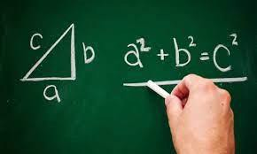
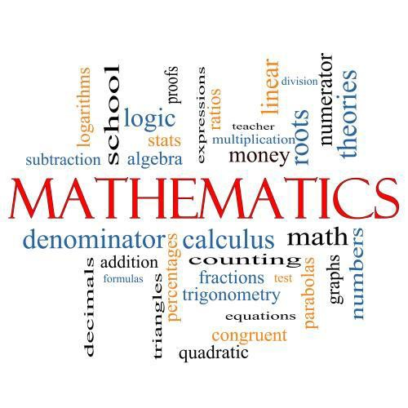

Course Information: Mathematics
We study the linear Edexcel GCSE course for Mathematics. Students in year 10 continue on their hard work built upon through the previous three years studying at Heritage. The course comprises of five main strands of maths; Number, Algebra, Shape, Data and Ratio. Each skill is taught explicitly before making links and tackling problem solving style questions.
https://qualifications.pearson.com/en/qualifications/edexcel-gcses/mathematics-2015.html
For further information on this course please contact katie.cooper@heritage.ttct.co.uk

Slide 2
Assessment: Mathematics
Students complete three equally weighted exams at the end of year 11.
Paper 1 is a non calculator paper, with both Paper 2 and 3 allowing the use of a Scientific calculator. (we strongly recommend students purchase the CASIO calculator as used in school)
Students will take an exam at either higher (Grade 3-9) or foundation (Grade 1-5) and their tier of entry will be decided by class work, assessments and effort within lessons over the course.
For further information on this course please contact katie.cooper@heritage.ttct.co.uk

Slide 3
Do’s and Don'ts: Mathematics
Do’s | Don’ts
Come with an open mind Mathematics is to be enjoyed | Think there is only one correct method. Explore different ideas
Be willing to make a mistake | Just write the answer when working out a question
Try and make links between areas of maths and other subjects | Be afraid to get it wrong – we learn best when we grapple at a question
Push yourself each and every lesson. A pass in GCSE maths opens so many doors. | Compare yourself – we are all unique!
For further information on this course please contact katie.cooper@heritage.ttct.co.uk

Slide 4
Beyond Heritage: Mathematics
Further Education
Life/Employability Skills
Resilience overcoming difficult challenges
Potential Career Pathways
Options include A level Mathematics, Further Mathematics and Core Maths preparation and acceptance for University Degree Courses.
Acoustic consultant
Actuarial analyst
Actuary
Astronomer
Chartered accountant
Chartered certified accountant
Data analyst
Data scientist
Investment analyst
Research scientist (maths)
Secondary school teacher
Software engineer
Sound engineer
Statistician
Problem solving Wrestling with difficult maths questions requires powers of pragmatism
A grade four and above in maths is the pre requisite for entry to the next level of education
Analytical thinking Numbers do not lie, however, they can often mislead. The ability to analyse results and relate them to the real-world story they are telling can have a huge impact.
Related subjects include Engineering, Physics, Chemistry and Biology.
Organisation
maths develops organisation of thought. You have to be neat in your workings in order to get the answer right consistently. This clarity of thinking helps in organising the rest of your life
For further information on this course please contact katie.cooper@heritage.ttct.co.uk

