Slide 1
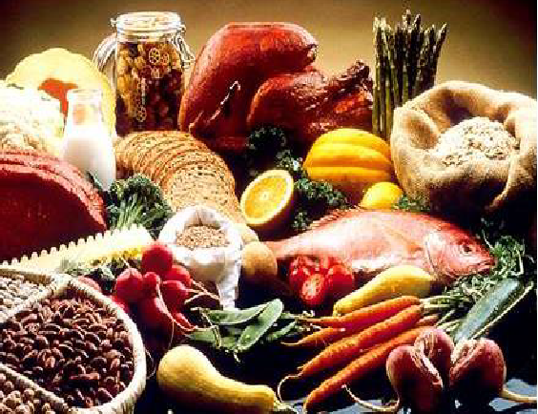
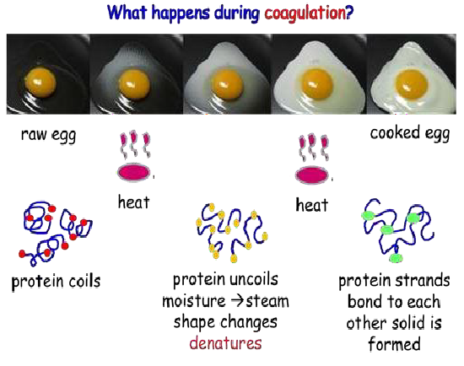
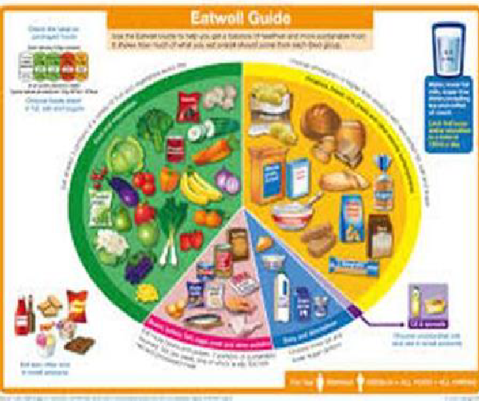
Course Information: Food
If you interested in food then you now have the opportunity to follow our two-year GCSE course to specialise in Food Preparation and Nutrition. GCSE Food Preparation and Nutrition covers a wide range of topics including where food comes from , principles of nutrition and health, food safety, food science and food preparation skills. Over the course of two years you will get the opportunity to develop your practical skills e.g. knife skills, use of the cooker and equipment, cooking methods, sauce making.
You will be making connections between theory and practice, applying your understanding of food and nutrition to practical preparation. Over the course of two years you will develop the knowledge and skills required to cook, and apply the principles of food science, nutrition and healthy eating, with transferable skills such as problem solving, time management and organisation.
For further information on this course please contact karen.rogers@heritage.ttct.co.uk

Slide 2
Assessment: Food
There is a high emphasis on practical skills and although these aren’t examined until the NEA tasks, they will be
taught and refined in the first year of the course. These include:
General practical skills
Knife skills
Preparing fruit and vegetables
Use of the cooker
Use of equipment
Cooking methods
The final GCSE grade will be made up of the following:
Prepare, combine and shape
Sauce making
Tenderise and marinate
Dough
Raising agents
Setting mixtures
- 50% Written exam – This will cover all elements included in the course content to test your understanding and application to recipes.
- 15% - NEA1 Food Investigation – This is a scientific investigation, previous tasks have included the types of fats used in pastry, raising agents, gluten.
- 35% -NEA2 Food Preparation – This is a research and make task. You will investigate a theme eg Mediterranean dishes, diet for someone deficient in iron, food suitable for a vegetarian. Produce trial dishes for your theme, a final 3 dishes during a 3 hour practical exam and then evaluate your results.
Grades 9-1 awarded.
For further information on this course please contact karen.rogers@heritage.ttct.co.uk

Slide 3
Do’s and Don'ts: Food
Do’s | Don’ts
Pick this course if you have a keen interest in Food Technology and have enjoyed your lesson’s in Y7, Y8 and Y9 | Pick this course because you get on with the Teacher
Pick this course if you want to develop your creativity and problem solving skills | Don’t pick this course just because you might have a group of friends that will be picking it
Pick this course if you have aspirations of working in the Food industry | Pick this course if you think you will be doing practical every lesson, the majority of the course is theory/controlled assessment
Pick this course if you are willing to put the effort in. In class and at home. | Pick this course as you think it is easy…There are NO easy courses! NB. Health & safety means no long nails!
For further information on this course please contact karen.rogers@heritage.ttct.co.uk

Slide 4
Beyond Heritage: Food
Further Education/Apprenticeships A Level/College Courses
Life/Employability Skills
Potential Career Pathways
Technical ability
You will develop preparation skills and specialist
knowledge of food and nutrition
Problem solving
You will develop problem solving skills and creative thinking to recognise problems and their causes, to identify a range of possible solutions and then assess and decide the best way forward.
Organisation
You’ll need to be able to prioritize work and meet strict deadlines while also achieving the course criteria, this is important within hospitality and catering.
Creativity
You will develop your creativity by adapting dishes to suit a chosen brief.
Analytics
You’ll be collecting and examining information in detail to arrive at a solution, to answer a key question or make an informed decision.
Discipline
You need to know and do what is expected of you. This ranges from organising yourself, being on time, to being responsible. Some jobs need particular discipline skills such as being able to persevere with the task and plans until you accomplish them.
Working in the hospitality industry
Development chef for major supermarkets or food manufacturers
Food product buyer for major supermarkets of food manufacturers
Food scientist
Dietician/nutritionist
Baker
Private chef
Chef in the armed forces
Environmental health officer
Confectioner
Food technologist
Including courses in culinary skills, Hospitality & Catering and professional cookery in preparation and acceptance for Further Education or Apprenticeships.
Apprenticeships could include Chef, bakery, catering, patisserie and confectionary, butcher, food technologist
Related subjects Biology, Chemistry, Health and social care, Sport science.
For further information on this course please contact karen.rogers@heritage.ttct.co.uk

