Slide 1


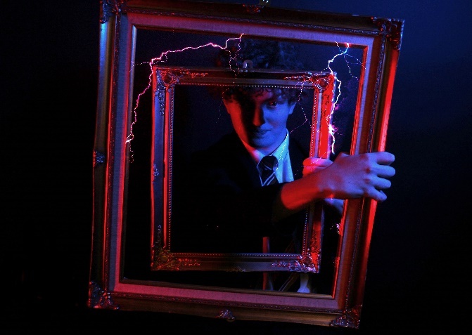
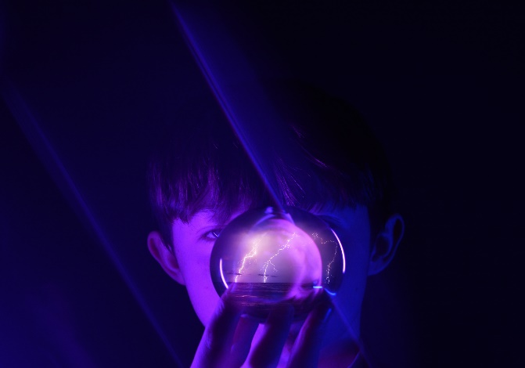
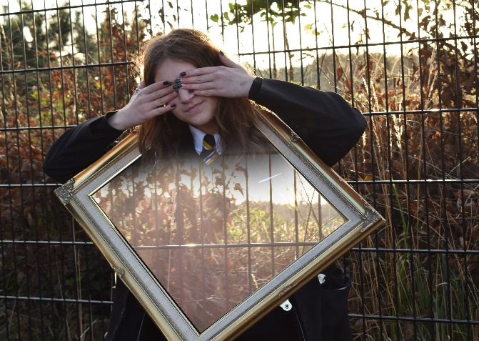
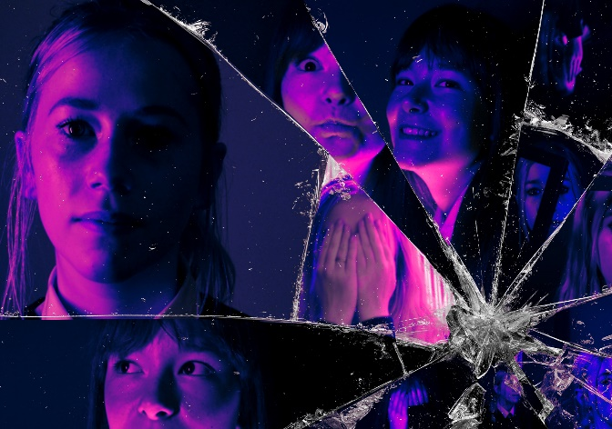
Course Information: GCSE Photography
Photography is defined as the practice of creating durable static or moving images by recording light with light-sensitive materials such as photographic film or digitally by means of an image sensor. You will learn how to use a DSLR camera in Manual mode and control Exposure. As a result, by the end of the course you will have an understanding of how to control Aperture, Shutter Speed and ISO.
Learners will explore and develop skills, knowledge and understanding through the application of traditional and/or digital techniques and processes specific to their chosen area(s) of study of Photography. You will learn how to edit Photographs using Adobe Suite techniques. This course will provide learners with the opportunity to explore practical and relevant critical/contextual sources, such as the work of historical and contemporary photographers.
For further information on this course please contact jordan.fowler@heritage.ttct.co.uk

Slide 2
Assessment: GCSE Photography
You will be assessed across two Components.
Component 1
This is worth 60% of your overall qualification. You will produce a portfolio of work, which demonstrates a variety of skills and knowledge. In addition, you will demonstrate that you can work towards a theme, investigate the work of other artists, develop the use of media/techniques and then present a final response.
Component 2
This is worth 40% of qualification. This section of the course is classed as the None Exam Assignment (NEA), which is split into two sections. Part 1:You will be given an assignment paper with 15 themes on from the 2nd of January in year 11. You must select one of these themes to respond to. You will then investigate appropriate artists and develop your own ideas in response to the theme. Part 2:You will then complete a 10-hour exam to create a final outcome/s.
For further information on this course please contact jordan.fowler@heritage.ttct.co.uk

Slide 3
Do’s and Don’ts: GCSE Photography
Do’s | Don’ts
Pick this course because you have an interest in Photography and enjoy practical subjects | Pick this course because you get on with the Teacher
Pick this course if you want to develop your creativity, problem solving, analysis and evaluation skills | Pick this course just because you might have a group of friends that will be picking it
Pick this course if you have aspirations of working in the creative industries | Pick this course if you think you will be just tsking ‘selfies’.
Pick this course if you are willing to put the effort in, during class and at home | Pick this course if you think it will be easy…There are NO easy courses!
For further information on this course please contact jordan.fowler@heritage.ttct.co.uk

Slide 4
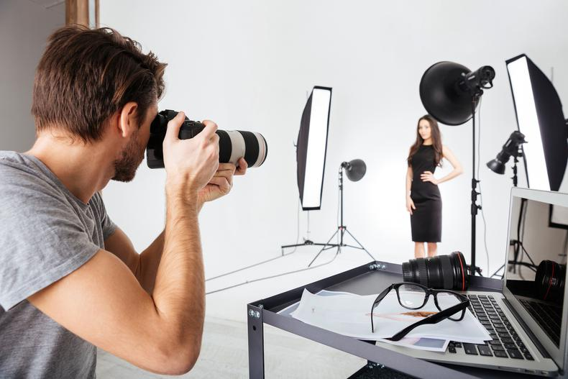
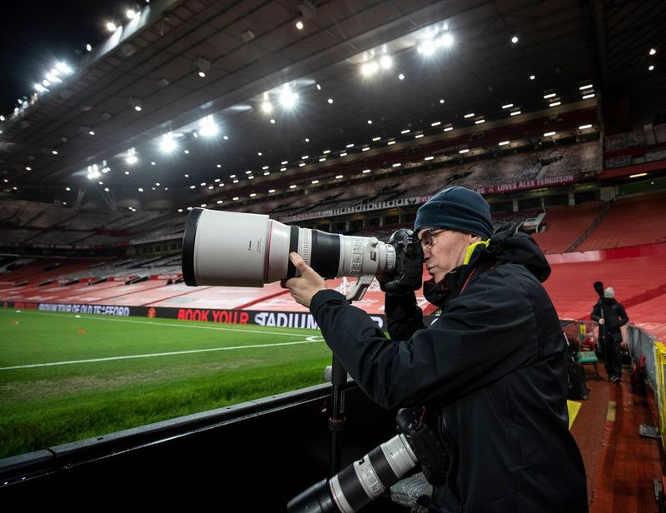
Beyond Heritage: GCSE Photography
Life/Employability Skills
Problem solving- You will develop problem solving skills through your practice as a Photography student. For example, you will learn how to apply the correct manual settings on the DSLR camera to control exposure and movement effectively.
Organisation- you will need to be able to prioritize workflow and meet strict deadlines, including fulfilling GCSE criteria.
Creativity- You will respond to a selection of specific themes and produce a range of appropriate final outcomes. You will also learn how to present your portfolio in a professional and coherent manner.
Discipline- You need to follow the teacher’s expectations and respect the learning environment. This includes organising your time independently, using the equipment appropriately and behaving responsibly.
For further information on this course please contact jordan.fowler@heritage.ttct.co.uk

Slide 5
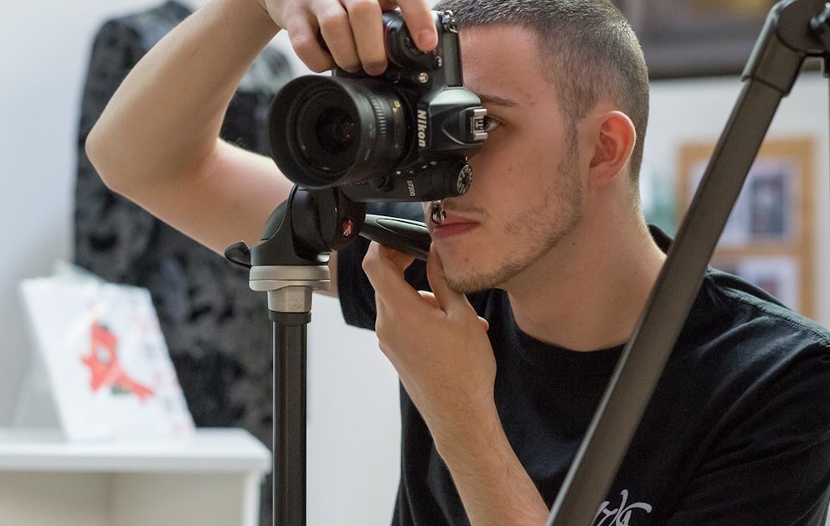
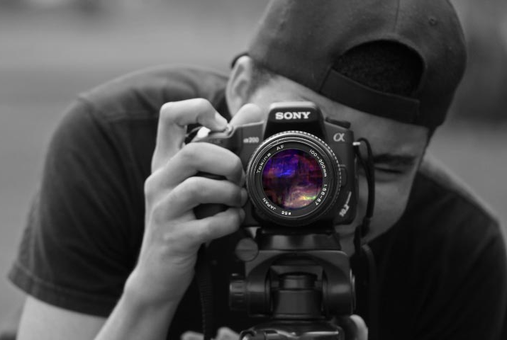
Beyond Heritage: GCSE Photography
Further Education
Potential Career Pathways
Photography (A-Level)
Games Development and Design (Level 3 Extended Diploma)
Journalism: Digital Broadcasting (Level 6 Degree)
Film and Digital Broadcast Production (A-Level)
Digital Design (Foundation Degree)
Digital Design and Animation (Level 3 BTEC Extended Diploma)
Digital Marketing (Level 3 UAL Extended Diploma)
Graphic Designer
Advertisement and Product Marketing
TV, Broadcasting and Video Editor
Freelance Wedding Photographer
Commercial Photographer
Architect
Film Set Designer
Photojournalism
Wedding Photographer
Press Photographer
Film Editor
For further information on this course please contact jordan.fowler@heritage.ttct.co.uk

