Slide 1
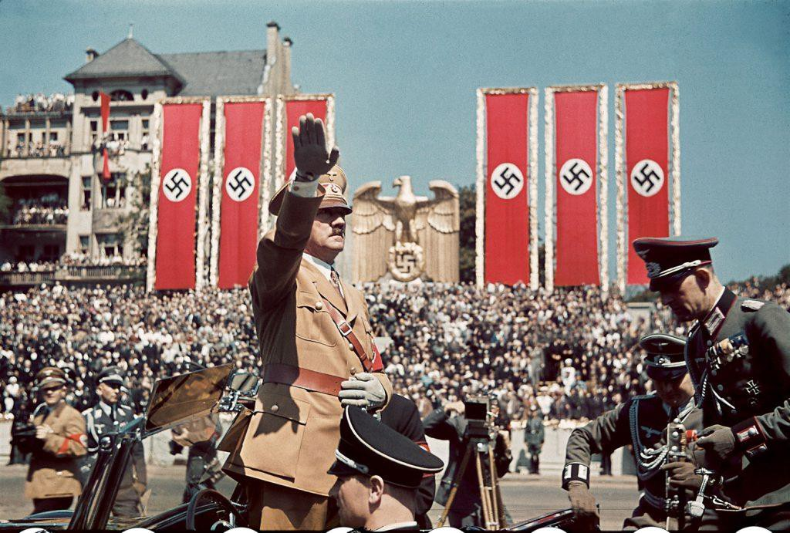
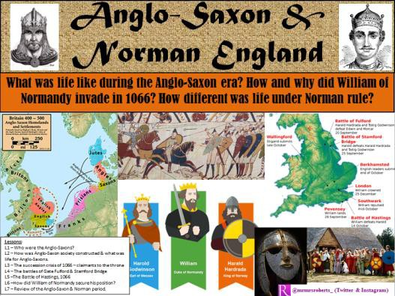
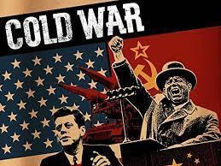
Course Information: History
History is, above all else, a study of human beings- our achievements and our mistakes.
As well as learning about history, learning from history will make you a more rounded and well-informed citizen, better able to understanding how the world is now and equipped with a zeal to make it an even better place.
For further information on this course please contact mark.cooper@heritage.ttct.co.uk

Slide 2
What will I study?: History
Unit 1: The rise of the Nazis 1919-39.
Students will examine the events that gave Hitler the opportunity to take control of Germany and how he managed to shaping the German people in his own image. Probably the biggest lesson we can learn from history.
Unit 2: The Cold War, 1941-91.
Students will study the rivalry between the USSR and USA while focussing on key events such as the space race, the Cuban Missile Crisis and the Berlin Wall (from its construction to its destruction).
Unit 3: Anglo-Saxon and Norman England 1060-88. Students will examine how England was set on a new path after William the Conqueror’s victory at the Battle of Hastings
Unit 4: Crime and punishment in Britain, c1000-present.
Students will look at how crime and punishment has evolved over time including questions such as: Why were so many women accused of witchcraft in the 1500s? Is terrorism a new crime? Why did Britain abolish the death penalty? Why was Jack the Ripper never caught?
For further information on this course please contact mark.cooper@heritage.ttct.co.uk

Slide 3
Assessment: History
All assessment is by examination:
Paper 1 (30%): Crime and Punishment- 1 hour 15 minute exam.
Paper 2 (40%): Anglo-Saxon and Norman England (20%) and The Cold War (20%)- 1 hour 45 minute exam.
Paper 3 (30%): The Rise of the Nazis- 1 hour 20 minute exam.
For further information on this course please contact mark.cooper@heritage.ttct.co.uk

Slide 4
Beyond Heritage: History
A Levels
You’ll learn valuable skills…
Potential Career Pathways
Most 6th forms require at grade 5 to
continue on with History.
excellent communication and writing
skills
how to construct an argument
research and problem skills
investigation and problem-solving
skills
analytical and interpretation skills.
Journalism
Law
Business
Politics
Marketing
Archaeologist.
Librarian.
Reporter.
Political analyst.
Heritage manager.
Business consultant.
Historian.
As History links will with lots of other subjects (including English, Law and Politics) it is a good subject to continue with at A level as it helps support your other A levels.
History is considered a good GCSE by Universities as it develops your analytical skills.
A-Level History continues to be one of the most popular A-Levels, showing how many students want to carry on learning about it!
For further information on this course please contact mark.cooper@heritage.ttct.co.uk

