Slide 1

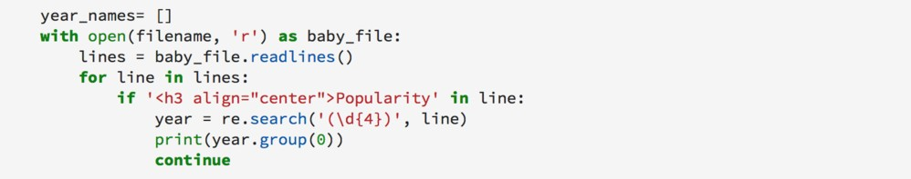
Course Information: Computer Science
The Edexcel Computer Science GCSE is the perfect steppingstone for students aiming for a career in the computing sector, such as cybersecurity, multimedia programmers, systems analyst and the game development industries. You’ll learn about the fundamentals of computer science including units of work covering, data, hardware and networking, as well as how computing impacts on our lives in different ways. This theory will be studied alongside a programming language. Using a text- based language you will learn to create solutions to complex problems.
The aims and objectives of this qualification are to enable you to:
Understand and apply the fundamental principles and concepts of computer science, including abstraction, decomposition, logic, algorithms, and data representation
Analyse problems in computational terms through practical experience of solving
such problems, including designing, writing and debugging programs
Think creatively, innovatively, analytically, logically and critically
Understand the components that make up digital systems and how they communicate with one another and with other systems
Understand the impact of digital technology on wider society, including issues of
privacy.
For further information on this course please contact emma.trevis@heritage.ttct.co.uk

Slide 2
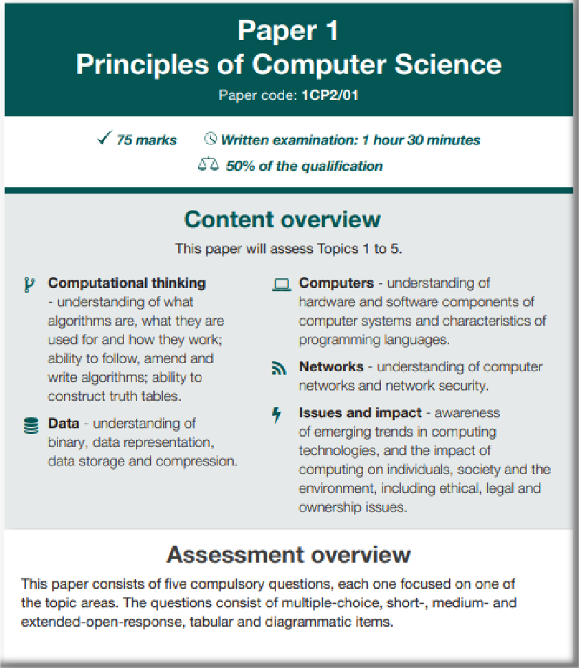
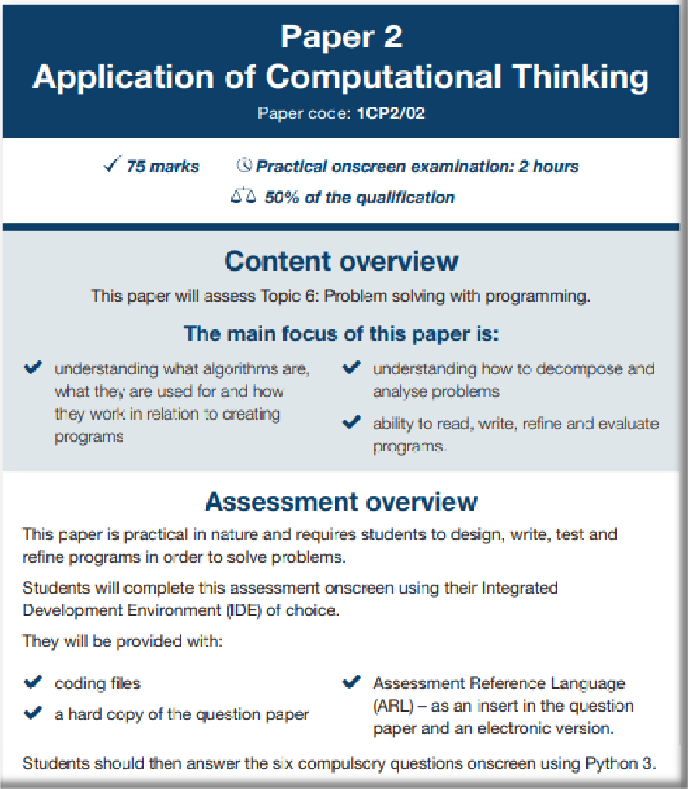
Assessment: Computer Science
Click here to be taken to the Python IDE
download page
For further information on this course please contact emma.trevis@heritage.ttct.co.uk

Slide 3
Do’s and Don'ts: Computer Science
Do’s | Don’ts
Pick this course if you have a keen interest in Computing (not gaming!) and have enjoyed your lesson’s in Y7 and Y8 | Pick this course because you get on with the Teacher
Pick this course if you want to develop your creativity, problem solving, analysis and evaluation skills | Don’t pick this course just because you might have a group of friends that will be picking it
Pick this course if you aspire to working in the Computing industry | Pick this course if you think you will be doing practical every lesson, the majority of the course is theory/controlled assessment
Pick this course if you work well independently and you like to spending time solving problems | Pick this course so you can dismantle and rebuild computers or make games – we don’t do this at all.
Pick this course if you are willing to put in the effort, both in class and at home. | Pick this course as you think it is easy…There are NO easy courses!
For further information on this course please contact SNewton2@heritage.derbyshire.sch.uk

Slide 4
Beyond Heritage: Computer Science
Further Education/Apprenticeships
Life/Employability Skills
Technical ability
You will develop technical skills and specialist knowledge of
how computers work.
Problem solving
The majority of Computing and IT roles require problem solving skills and creative thinking to recognise
problems and their causes, to identify a range of possible solutions and then assess and decide the best way forward. Organisation
You’ll need to be able to prioritize work and meet strict deadlines while also achieving the course criteria Creativity
You will develop your ability to problem solve through the creation of complex algorithms. Solutions will solve problems using efficient sets of instructions.
Discipline
You need to know and do what is expected of you. This ranges from organising yourself, being on time, to being responsible. Some jobs need particular
discipline skills such as being able to persevere with the task and plans until you accomplish them.
Mathematical Skills
Complex mathematics will be used throughout units on problem solving and programming. You will learn to perform calculations using binary and to create
complex expressions to calculate file size and data transfer
rates.
Potential Career Pathways
Bioinformatics Business analysis
Computer aided design
3D modelling and animation Programming
Computer games testing Cyber security
IT consultant IT support
Database administration Multimedia development IT project management Teaching
Web development Systems developer Network manager Social media manager Software engineering
Computer hardware engineering
A Level/College
Courses Including Level 3 BTEC and A level Computer Science and IT Courses in preparation and acceptance for University Degree Couse's or Apprenticeships.
Apprenticeships could
include computer engineering roles, working with artificial intelligence, communications, networking and Internet and media-based careers, software engineering
and development
Related subjects include IT, Media
and Mathematics
For further information on this course please contact emma.trevis@heritage.ttct.co.uk

