Slide 1
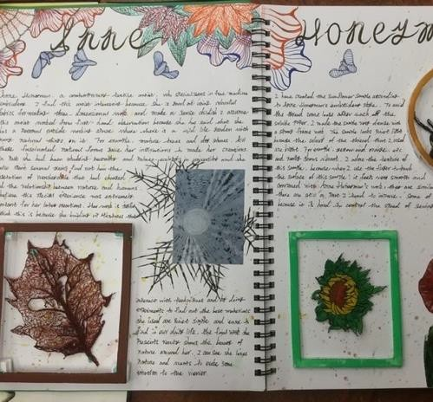
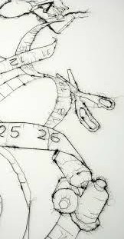
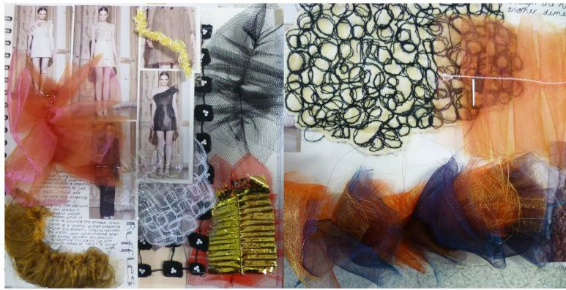

Course Information: Textile Design
A GCSE in Textile Design will help you towards careers in the Design and Creative industries sectors. You will develop your knowledge from KS3 of a variety of different artists and refine your level of skills in a range of media.
You will work in a similar manner to KS3 but in much more depth: you will work to a theme, then investigate the work of other artists. You will develop ideas through exploring media and produce your own piece in response.
From the Specification: ‘This title is defined as the
creation of designs and products for woven, knitted, stitched or printed fabrics and involves an understanding of fibres, yarns and fabrics. Areas of study include; Constructed textiles, Digital textiles, Dyed fabrics, Printed fabrics, Fashion design, Installed textiles, Soft furnishings, Stitched and/or embellished textiles. Work is not limited to one area of study.’
https://www.eduqas.co.uk/qualifications/art-and-design-gcse/#tab_overvi

Slide 2
Assessment: Textile Design
There are 2 Components which you will be assessed on in GCSE in Textile Design. You will be assessed against these 4 assessment objectives: AO1 Critical understanding AO2 Creative making AO3 Reflective recording AO4 Personal presentation
Component 1: 60% of qualification: 120 marks A portfolio of work which you will produce in your first and second year of the course. In your portfolio you will demonstrate that you can work to a theme, investigate the work of other artists: in order to show the influence of their work on your own, explore and develop your use of media then present a final response.
Component 2: 40% of qualification: 80 marks “NEA” this is the None Exam Assignment. Part 1:You will be given an assignment paper with 15 themes on from the 2nd of January in your 2nd year. You must select one of these themes to respond to. You will then investigate appropriate artists and develop your own ideas in response to the theme. Part 2:You will then have 10 hours of supervised time to make a final outcome or response

Slide 3
Do’s and Don'ts: Textile Design
Do’s | Don’ts
Pick this course if you have a keen interest in Textiles and have enjoyed your lesson’s in Y7 and Y8 | Pick this course because you get on with the Teacher. Don’t pick this course just because you might have a group of friends that will be picking it
Pick this course if you want to develop your creativity, problem solving, analysis and evaluation skills | Pick this course because you think it is all about fashion. It is an art based coursed.
Pick this course if you have aspirations of working in the Textile industry | Pick this course if you think you will be doing practical every lesson, the majority of the course is theory/controlled assessment.
Pick this course if you are willing to put the effort in, in class and at home. | Pick this course as you think it is easy…There are NO easy courses!

Slide 4
Beyond Heritage: Textile Design
Further Education Further Education/Apprenticeships A Levels in
Textile Design
Graphic Communication
Three-dimensional Design
Photography
Art and Design
Critical and Contextual Studies
Life/Employability Skills
Technical ability
You will develop technical skills through practical samples and investigate this with artist influences.
Problem solving
You will develop problem solving skills through your practice as a textiles student: for example how to follow processes using photoshop, using the sewing machines and applying this to your portfolio.
Organisation
Meeting deadlines and demonstrating that you are following a process or research, experimenting and applying this to outcomes that are personal are important for this course.
Creativity
Personal responses are important in constructing your portfolio and you will have the opportunity to use many forms of media. For example, research, photography and drawings will be used to develop your ideas.
Analytics
The inspiration of artists’ work will be used to support your
ideas and show your understanding of their process.
Discipline
You need to know and do what is expected of you. This ranges from organising yourself and appropriate media and equipment, being on time, to being responsible and behaving appropriately at all times. This includes bringing your sketchbook to every lesson and showing your dedication outside of the classroom.
Potential Career Pathways
Fashion Designer
Interior Designer
Product Designer
Fashion illustrator
Accessory Designer
Surface Design
Fabric Designer
Textiles Educator
Theatre set designer
Costume designer
Jewelry designer
Film Prop designer/maker
Level 3 Btec
Textile Design and Manufacture
Fashion and Textiles (extended
diploma)
Fashion and Clothing (extended diploma)
Fashion, Textiles and Costume
or further information on this course please contact emily.jones@heritage.ttct.co.uk

