Slide 1

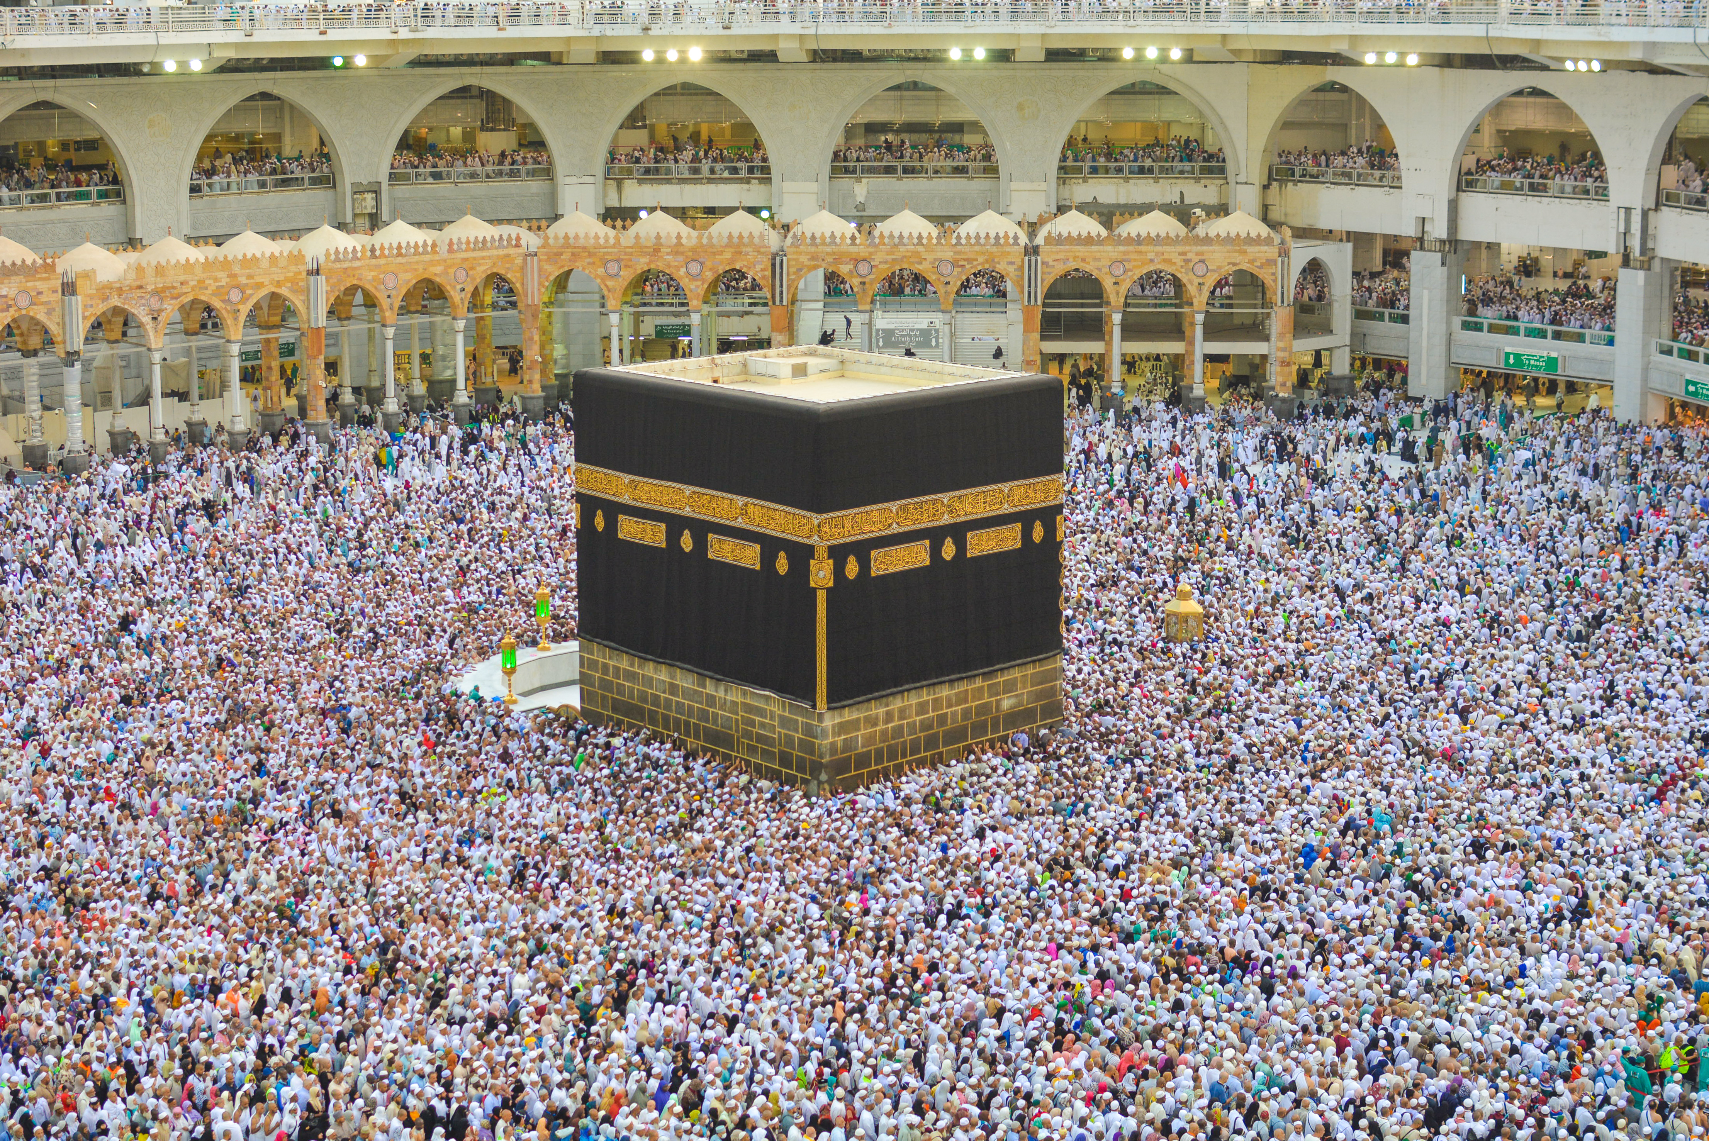

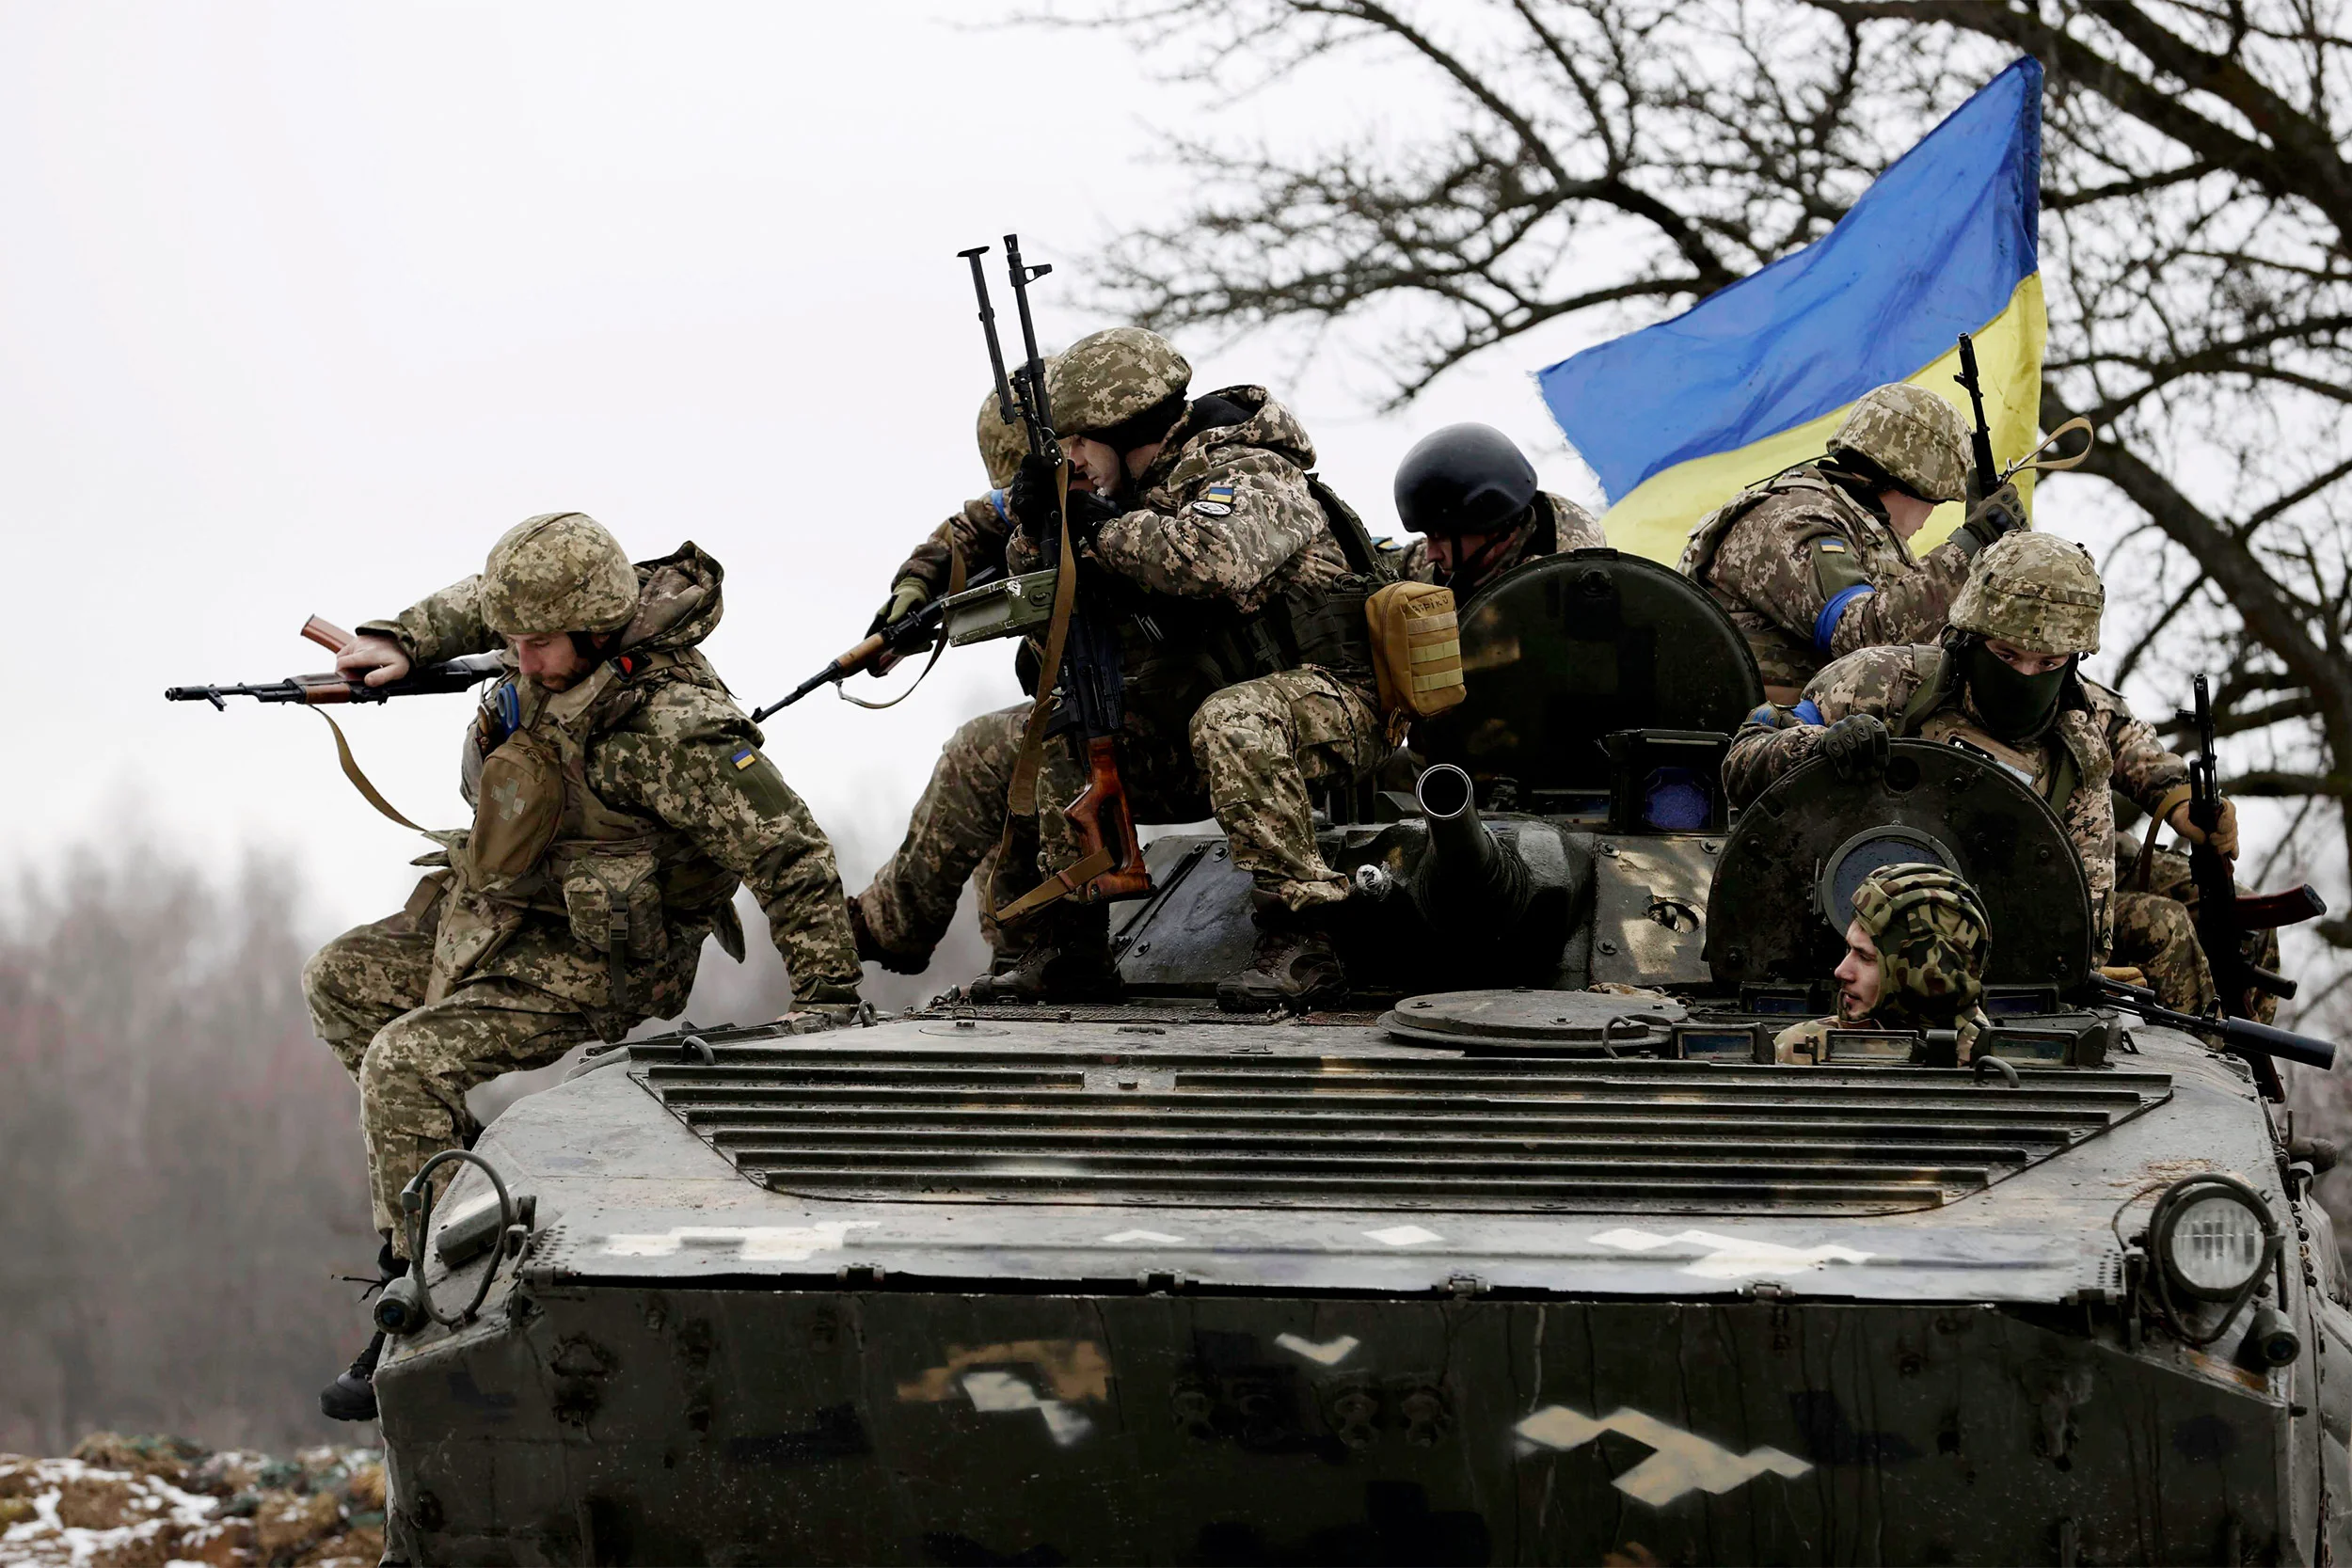

Course Information: Religious Studies Short Course (studied in Core RS)
All students will study for a GCSE Short Course in Religious Studies during their core RS lessons.
GCSE Religious Studies will help you to understand yourself and the people around you. You will study the beliefs of Christianity and Islam in depth.
You will then then look at how these beliefs affect people around the world and apply to issues facing humanity in the 21st Century. We will study Christian, Muslim and non-religious attitudes to issues around:
Relationships and families (such as what is the purpose of marriage, and attitudes to gender equality)
Peace and conflict (such as is it ever right to go to war, and how should those caught up in conflict be helped)
https://trs.ac.uk/studying-trs/graduate-videos/
For further information on this course please contact frances.morrell@heritage.ttct.co.uk

Slide 2
Assessment: Religious Studies Short Course (studied in Core RS)
This is assessed in 1 exam that will last for 1 hour and 45 minutes.
The paper is split into 4 questions. Each question is worth 24 marks. The Christianity and Islam questions each have 3 marks for Spelling, Punctuation and Grammar.
The questions are all structured the same, in 5 parts:
Multiple choice knowledge question - 1 mark
‘Give two’ knowledge question - 2 marks
Explain how beliefs influence believers (Christianity and Islam) / Explain contrasting beliefs about an issue (Themes) - 4 marks
Explain a belief - 5 marks
Evaluate a point of view about a belief - (Christianity and Islam) or issue (Themes) - 12 marks
Section 1:
Christianity
Section 2:
Islam
Section 3:
Relationships and families
Peace and conflict
For further information on this course please contact frances.morrell@heritage.ttct.co.uk

Slide 3
Do’s and Don'ts: Religious Studies Short Course (studied in Core RS)
Do: | Don’t:
Have a positive attitude towards studying the short course in Religious Studies. | Think it is easy…There are NO easy courses!
Be willing to develop your discussion, understanding, analysis and evaluation skills.​ | Forget that studying the short course will mean you have more GCSEs than someone who has not studied the short course.
Be willing to develop your understanding of how other people see the world and develop your own opinions about a range of issues.
Put the effort in, both in class and with your homework.​
For further information on this course please contact frances.morrell@heritage.ttct.co.uk

Slide 4
Beyond Heritage: Religious Studies
A Levels
Life/Employability Skills
Potential Career Pathways
Most 6th forms require at grade 5 to
continue on with Religious Studies.
Teamwork
Problem-solving
Advanced analytical skills
Written Communication
Verbal Communication
Planning
Creative thinking
Time management
Self-motivation and self-reliance
Adaptability
Empathy
Resilience
Independence
Advice worker
Archivist
Charity fundraiser
Charity officer
Chaplain
Civil Service administrator
Community development worker
Editorial assistant
Equality, diversity and inclusion officer
Mediator
Newspaper journalist
Police Officer
Policy officer
Prison Officer
Solicitor
Youth worker
As Religious Studies links with lots of other subjects (including English, Philosophy and Ethics, Psychology, Sociology and History) it is a good subject to continue with at A level as it helps support your other A levels.
You could then continue with Religious Studies, Philosophy or Theology at University as a degree on it’s own.
Alternatively, you can combine it with other degrees e.g. Teaching and Religious Studies.
For further information on this course please contact frances.morrell@heritage.ttct.co.uk

