Slide 1
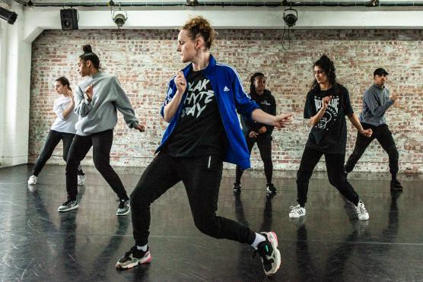
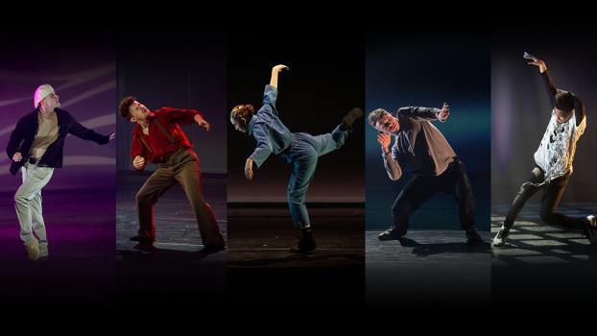
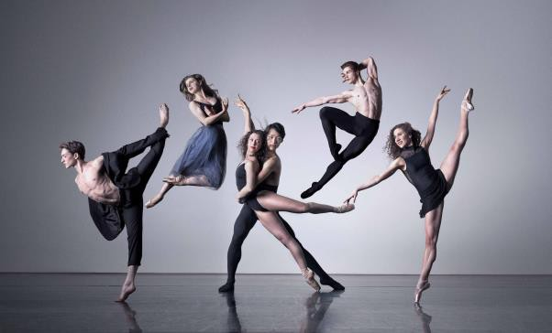
Course Information: BTEC Dance
The BTEC technical award in Dance will help you take your first steps towards a career in the performing arts sectors.
The Award gives learners the opportunity to develop sector-specific knowledge and skills in a practical learning environment. Learners will cover development of key skills such as reproducing repertoire or responding to stimuli. They will learn about process such as development of ideas, rehearsal and performance. The course will develop attitudes that are considered most important in the Performing Arts, including personal management and communication. Finally learners will improve knowledge such as roles, responsibilities, performance disciplines and styles.
For further information on this course please contact leila.smallman@heritage.derbyshire.sch.uk

Slide 2
Assessment: Dance
You will be assessed through a mixture of practical and theory work.
Component 1 – Worth 30% of the overall grade. This component is predominantly theory and learners will complete a piece of written coursework. This component will develop their understanding of the performing arts by examining practitioners’ work and the processes used to create performance.
Component 2 – Worth 30% of the overall grade. Learners will develop their performing arts skills and techniques through the reproduction of an existing dance piece as performers. Learners are required to develop skills and techniques for performance, apply skills and techniques in rehearsal and performance and review their own development and contribution to the performance.
Component 3 – Worth 40% of the overall grade. Learners will be given the opportunity to work as part of a group to contribute to a workshop performance as a performer in response to a given brief and stimulus. You will be given a brief that outlines the performance requirements and working as part of a group, you will develop your ideas for a workshop performance and apply your skills and techniques to communicate your creative intentions to your audience.
For further information on this course please contact leila.smallman@heritage.derbyshire.sch.uk

Slide 3


Do’s and Don'ts: Dance
Do’s | Don’ts
Pick this course if you have a keen interest in Dance and have enjoyed your lesson’s in Y7 and Y8- including performing to an audience | Pick this course if you are not willing to perform in front of other students.
Pick this course if you want to develop your dancing ability, confidence, and teamwork skills. | Don’t pick this course just because you might have a group of friends that will be picking it.
Pick this course if you have aspirations of working in the Performing Arts Industry. | Pick this course if you think you will be doing practical every lesson.
Pick this course if you are willing to put the effort in, in class and at home. | Pick this course if you don't usually bring PE kit to lessons or are unwilling to take part in practical tasks
For further information on this course please contact leila.smallman@heritage.derbyshire.sch.uk

Slide 4
Beyond Heritage: Dance
Further Education
Life/Employability Skills
Teamwork
You will have to work closely with others and will need to demonstrate communication and teamwork skills in order to meet the desired outcomes.
Organisation
You’ll need to be able to bring the correct kit to practical lessons and manage your rehearsal time in order to meet deadlines.
Creativity
You will develop creativity through a range of tasks; both practically and theoretically. You will learn to think in a more complex way in order to meet creative outcomes. Discipline
You need to know and do what is expected of you. This ranges from organising yourself, being on time, to being responsible.
Confidence
You will develop the confidence to perform /present in front of other people. This is an essential requirement of the course
Patience
You will need to remain patient when learning and rehearsing. You must show a willingness to persevere with the task until it is accomplished; this may include
rehearsing a dance a number of times over.
Potential Career Pathways
A Levels as preparation for entry to higher education in a range of subjects
Study of a vocational qualification at Level 3, such as a BTEC National in Performing Arts, which prepares learners to enter employment or apprenticeships, or to move on to higher education by studying a degree in the Performing Arts or Production Arts areas.
Dancer
Arts Administrator
Choreographer
Community Arts Worker
Dance movement
psychotherapist
Personal Trainer
Theatre director
Dance teacher within
education
Dance school teacher/owner
PE teacher with a dance specialism
Sports therapist
Talent agent
For further information on this course please contact leila.smallman@heritage.derbyshire.sch.uk

